Slide 1
Every lens has field curvature
Out of focus (“soft” edges/corners)
“Sag”
Flat object
Flat sensor
Curved image
For SPIM field curvature matters, because light-sheet is straight.
Field curvature reduces the resolution at the FOV edges.

Slide 2
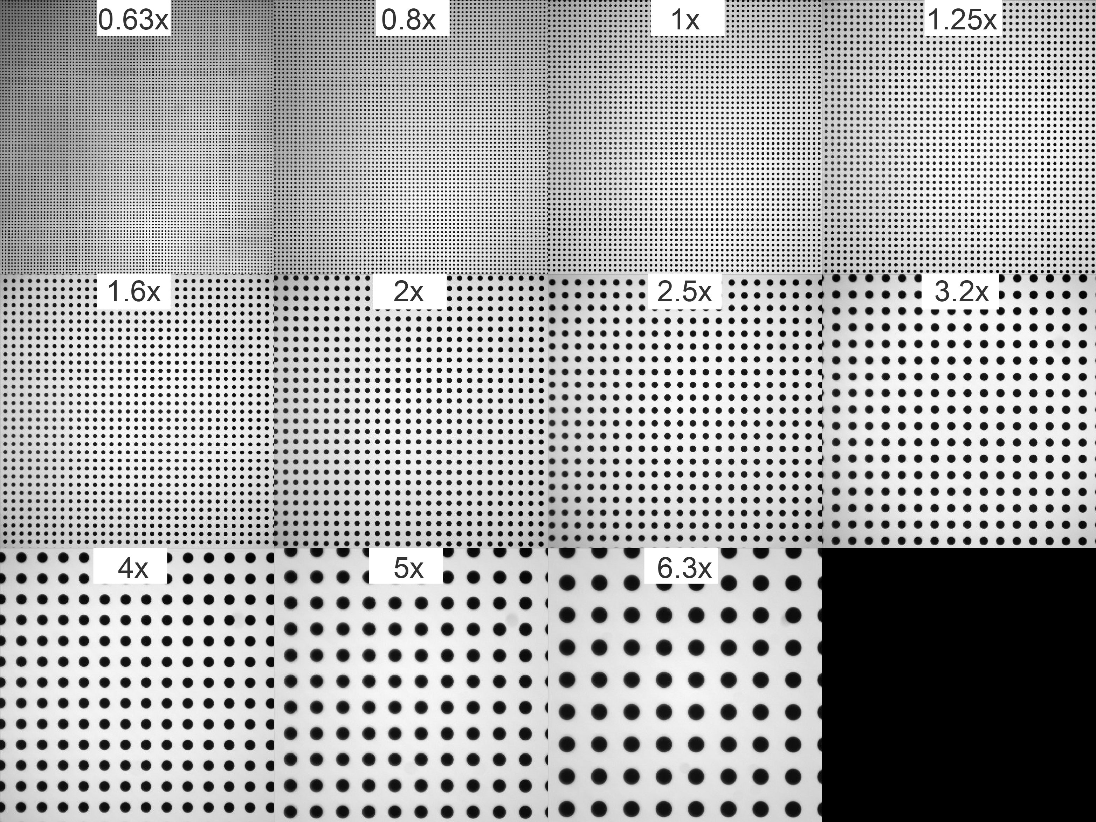
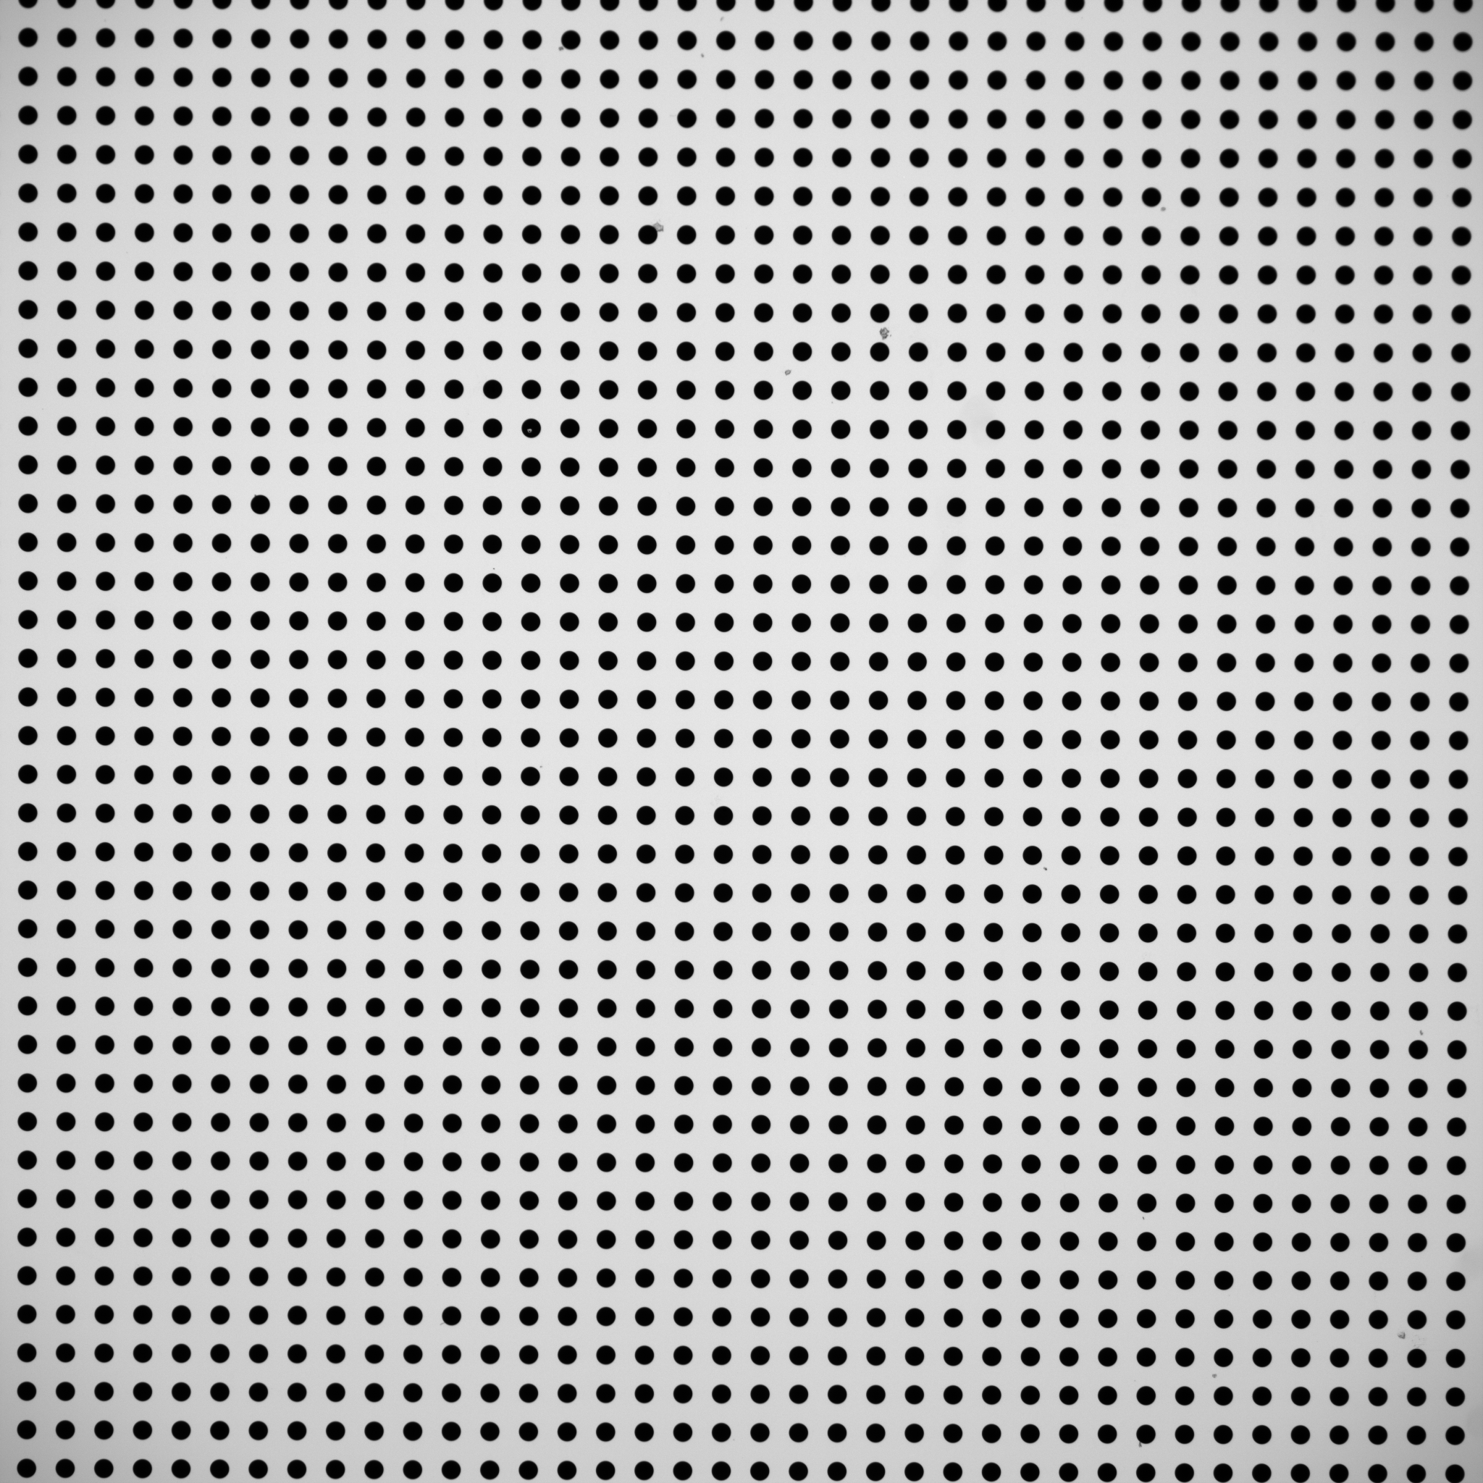
Field curvature testing for mesoSPIM detection lenses. Why bother?
1.25x
Olympus MVPLAPO1x
What does “soft” corner mean,
quantitatively?
Which lenses are good/bad?
Image courtesy: F. Voigt
Thorlabs R2L2S3P2 Grid Distortion Target, 1.5" x 1.5", 250 µm Grid Spacing

Slide 3
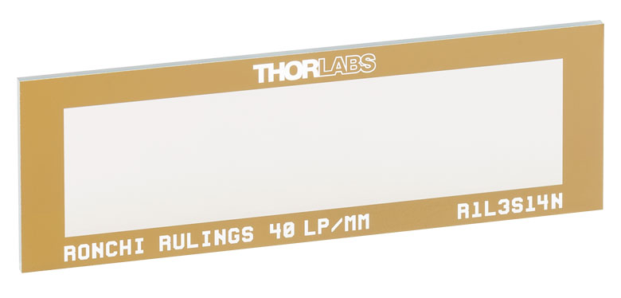
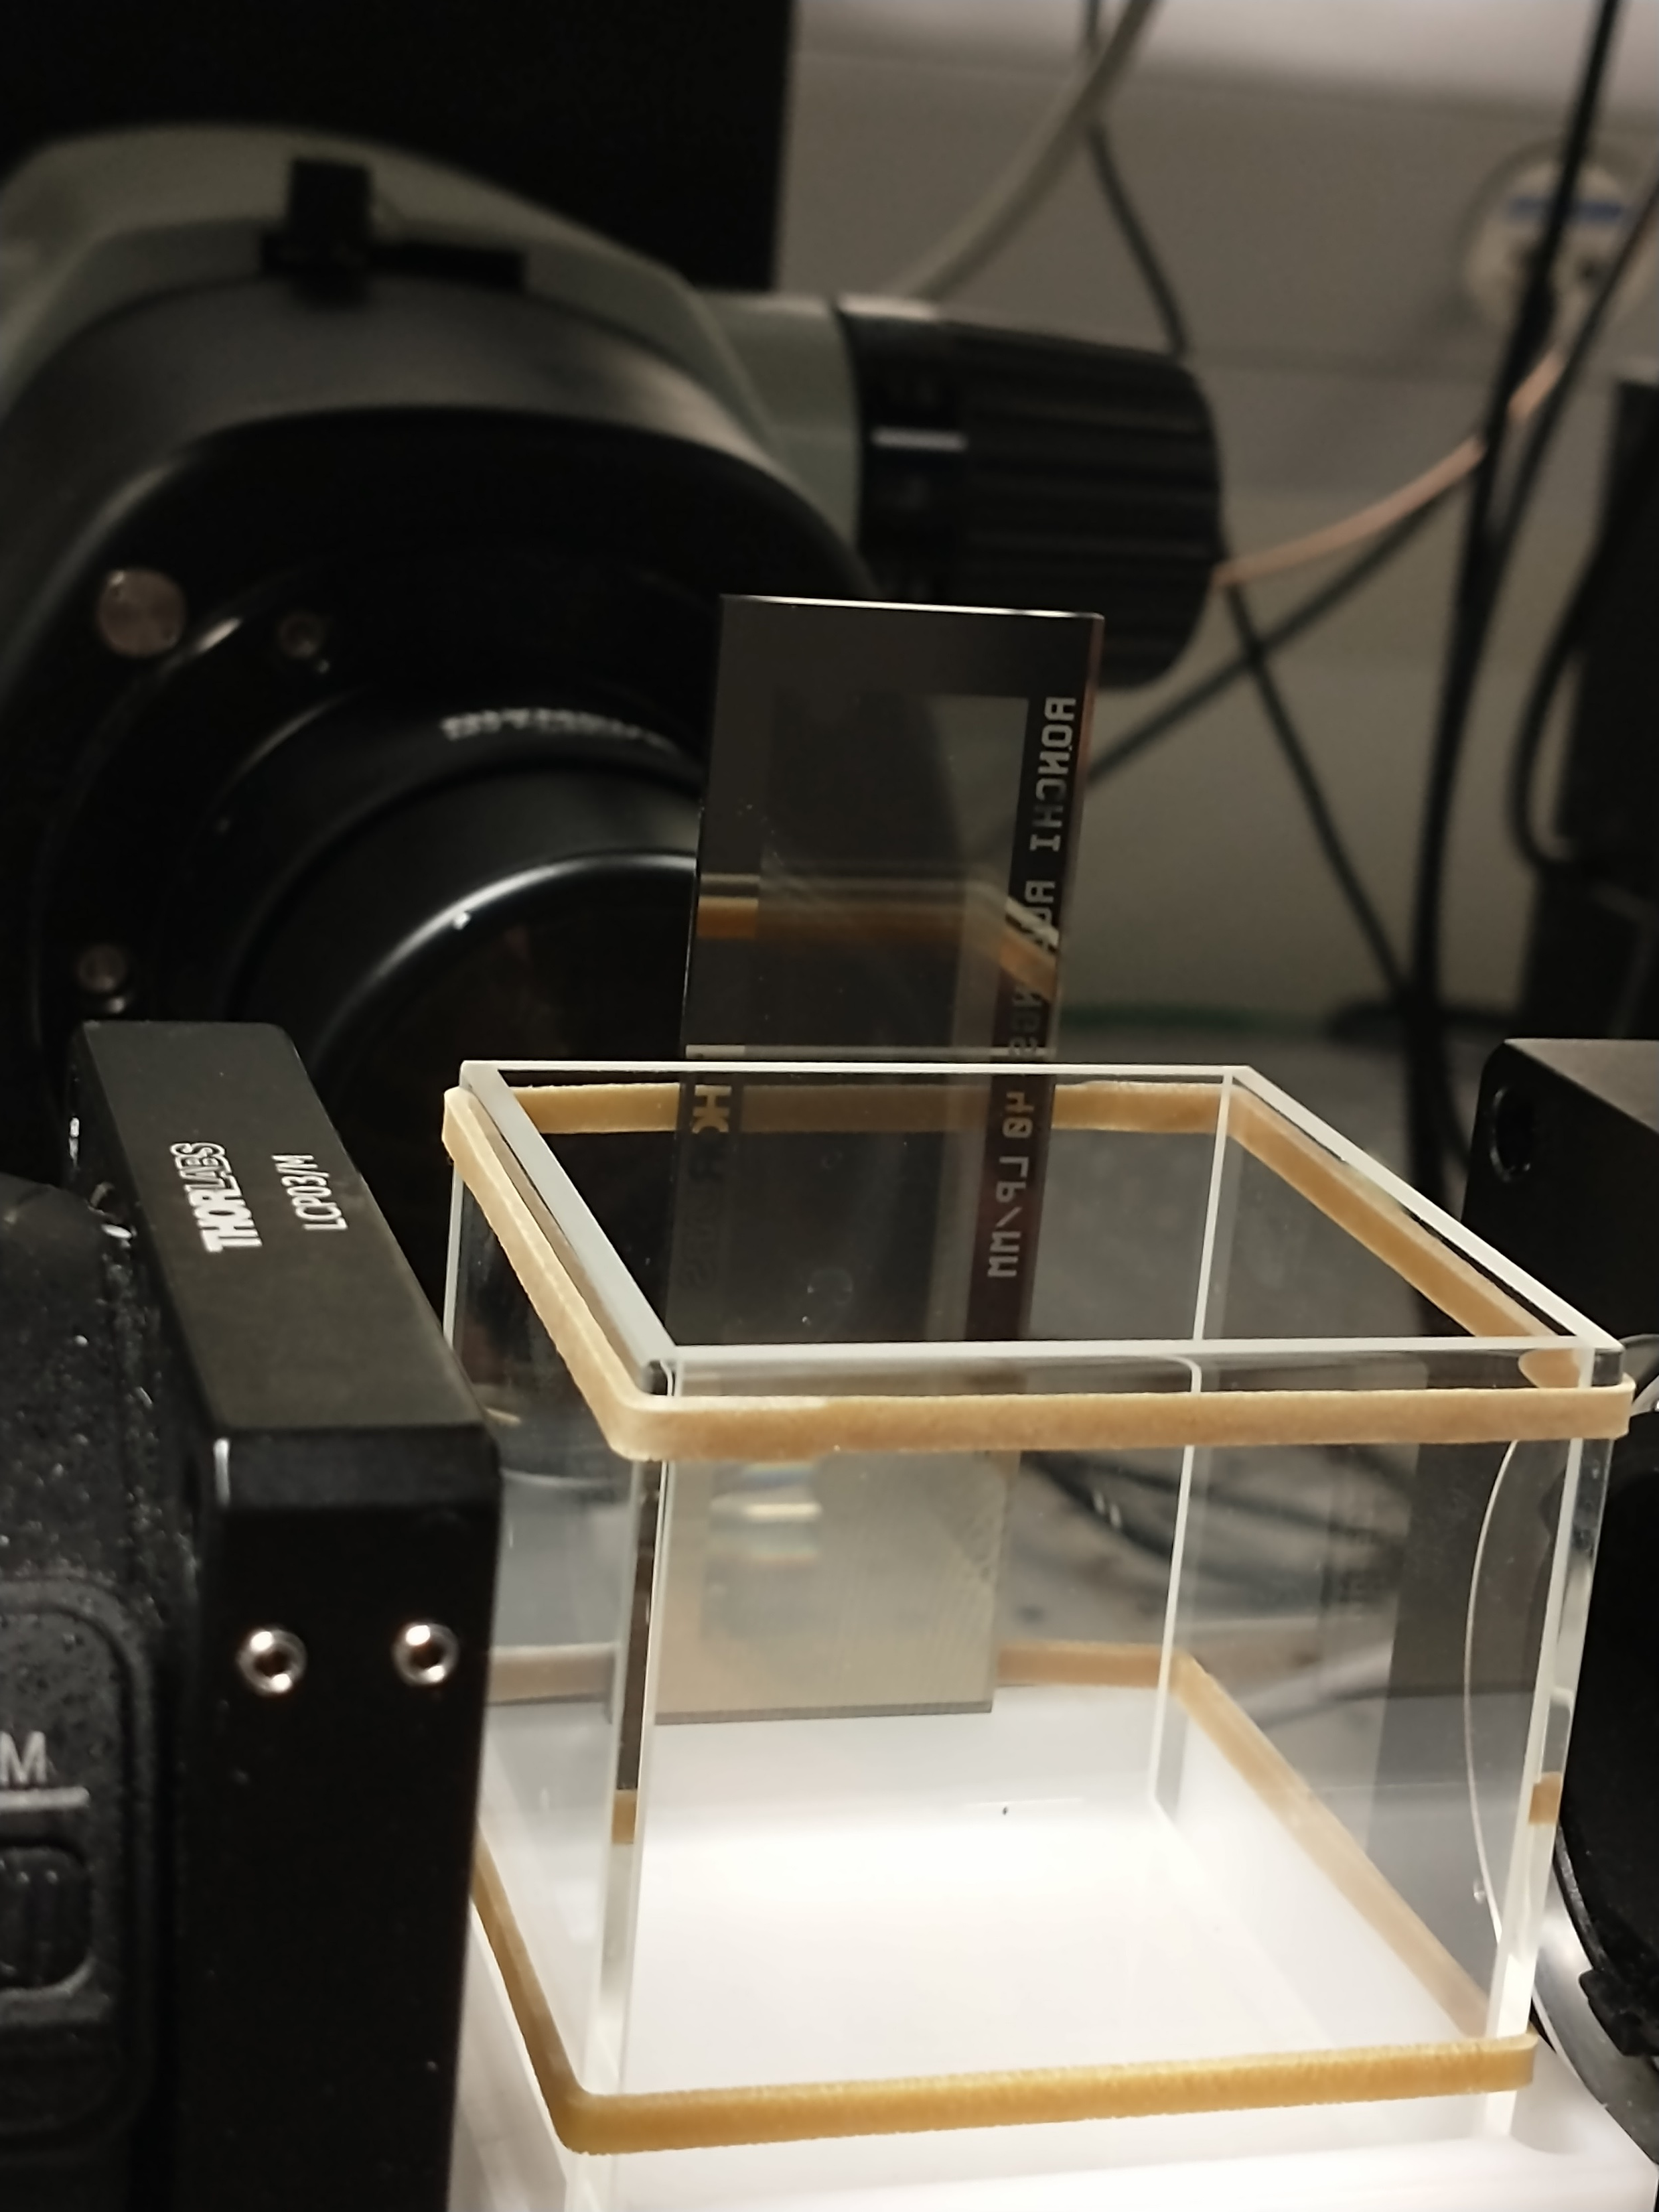
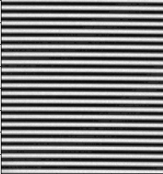
The testing apparatus
Thorlabs R1L3S14N - Ronchi Ruling Test Target, 3" x 1", 40 lp/mm
Imaging the Ronchi slide at different F-positions:
-300, -290, ... 0, ...., 290, 300 um
Illumination: smartphone screen.

Slide 4
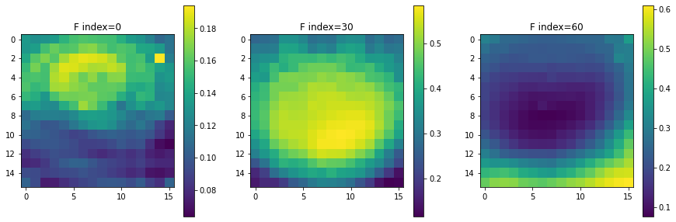
Contrast across FOV
Image divided into NxM tiles
for each z-plane:
for each tile (i,j): contrast(z,i,j) = (I_{max} - I_{min})/ (I_{max} + I_{min})

Slide 5
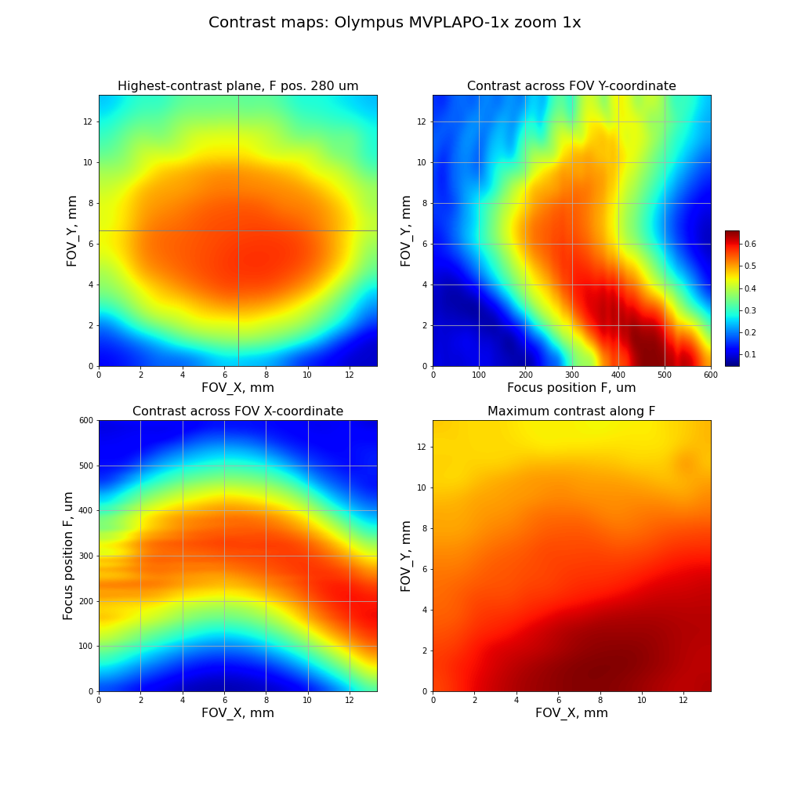
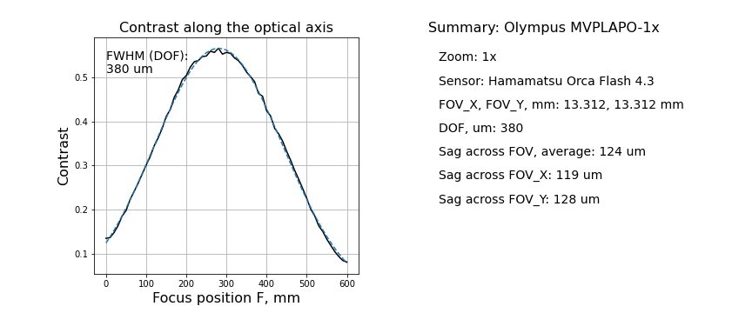
Zoom 1x
Unexpected findings from a real lens testing
Contrast field is not spherical,
... and not even axially symmetric
DOF (380 um) is larger than expected from a formula (170 um)
(probably because actual NA is smaller)
Field sag can be more than 100 um
(not ideal for SPIM)

Slide 6
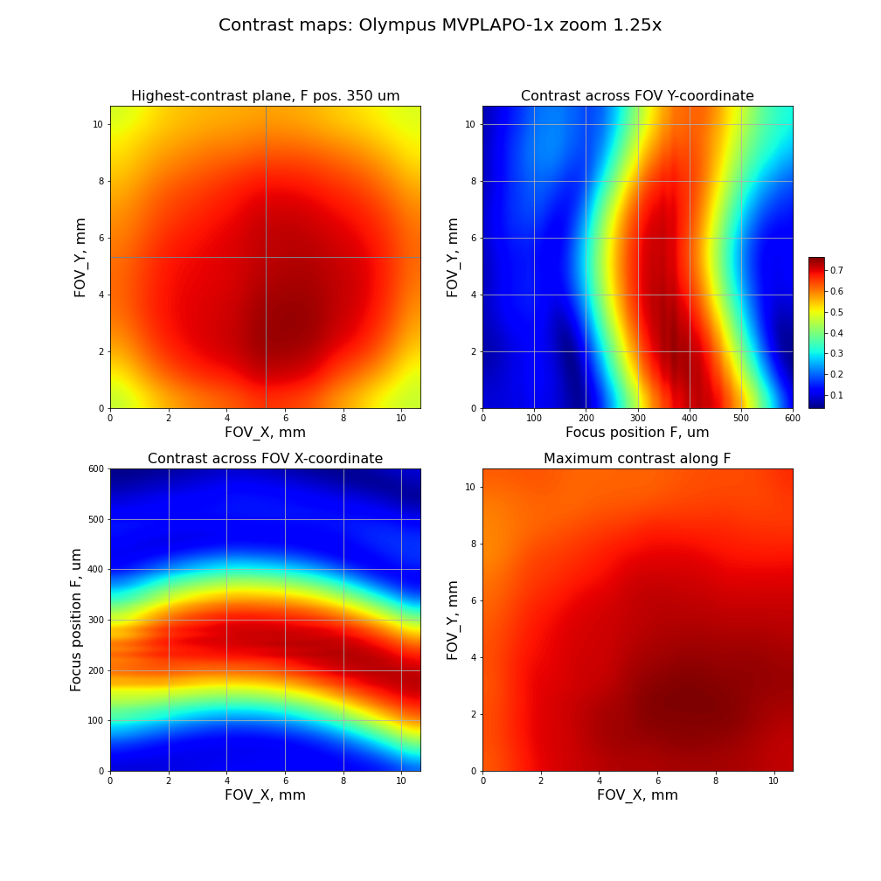
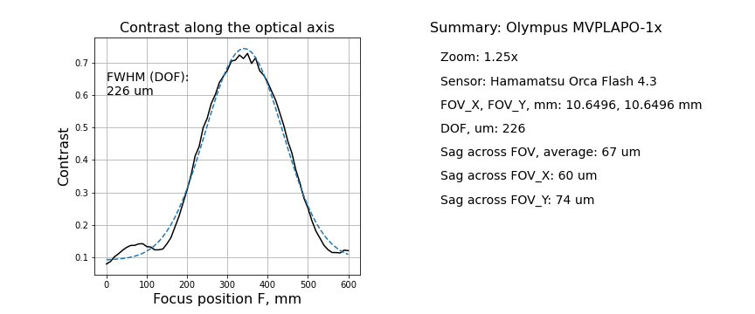
Zoom affects field curvature:
field becomes flatter (as expected),
but also changes sharpest areas
Zoom 1.25x

Slide 7
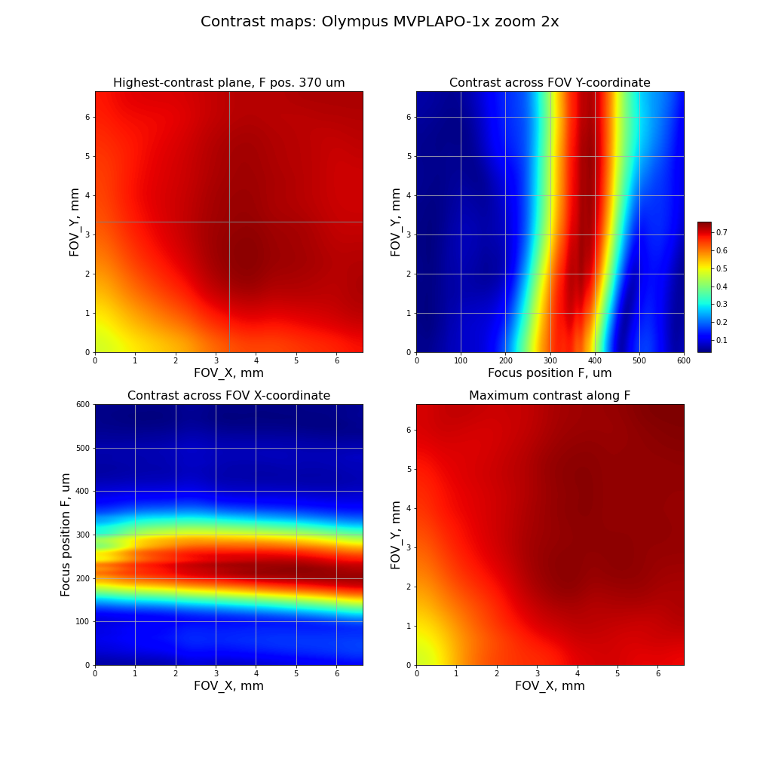
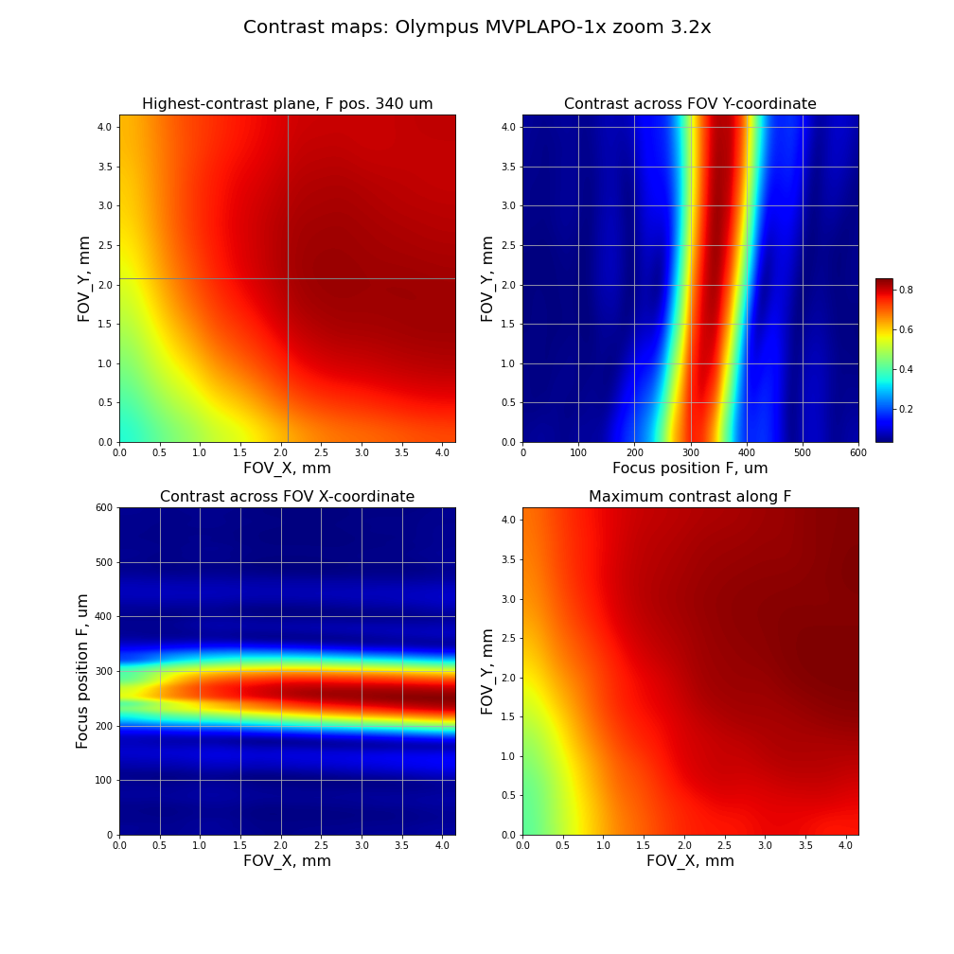
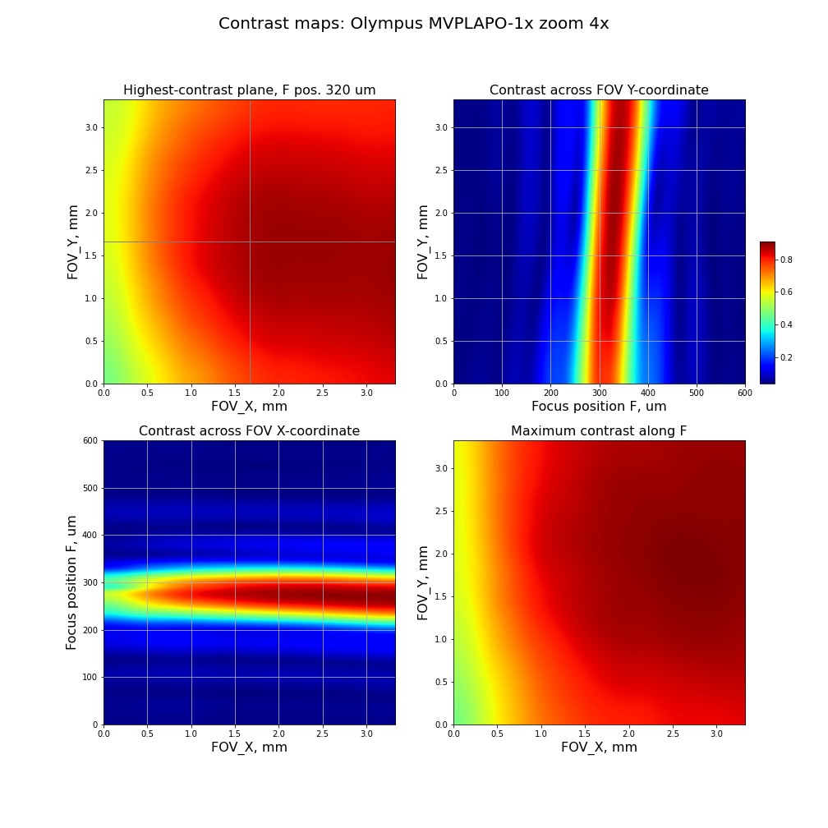
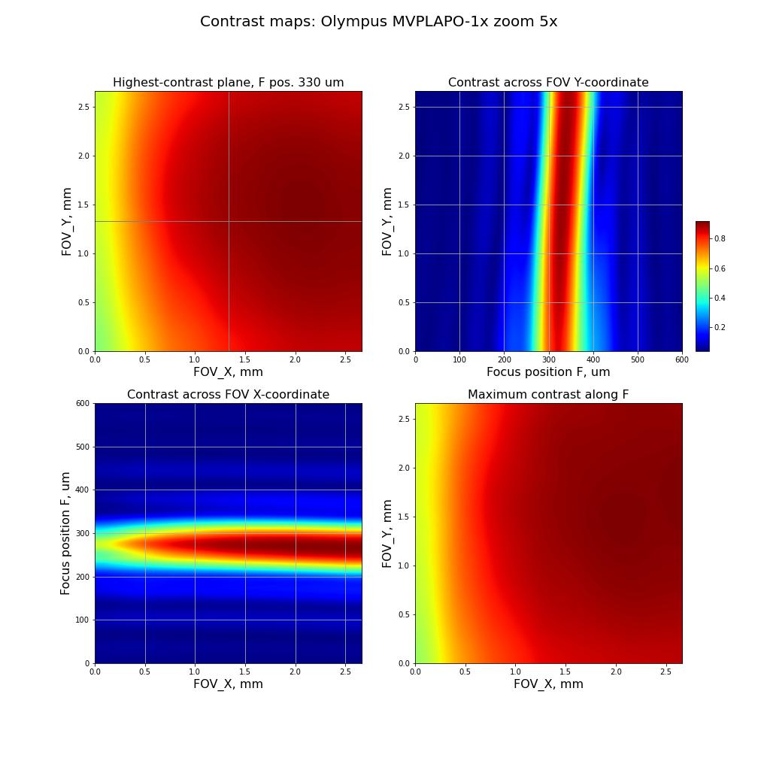
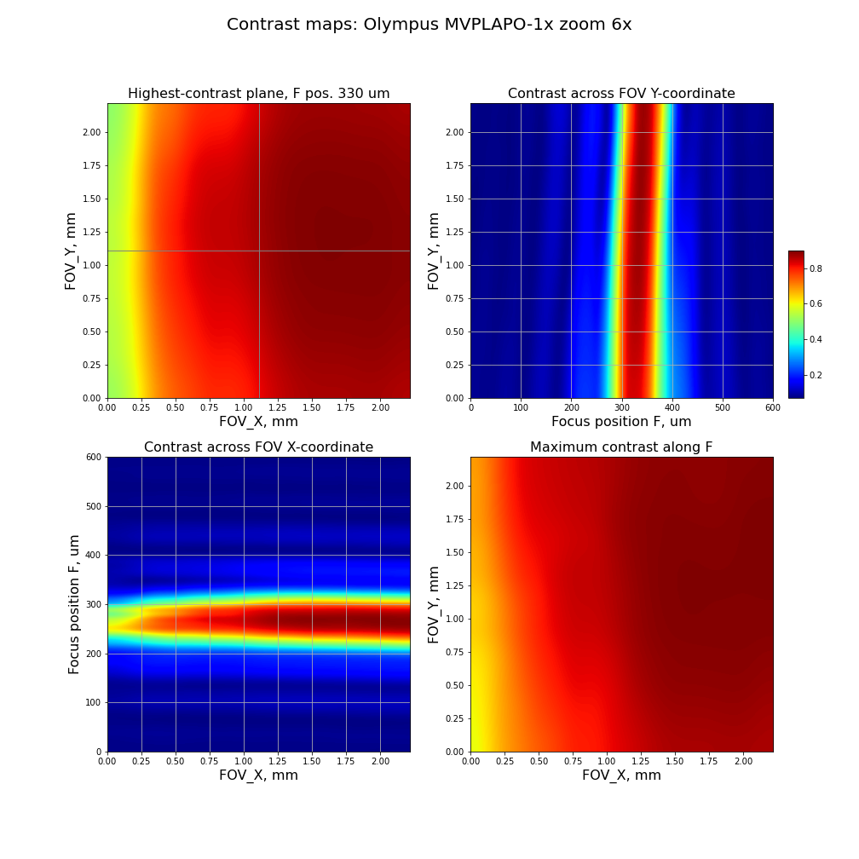

Slide 8
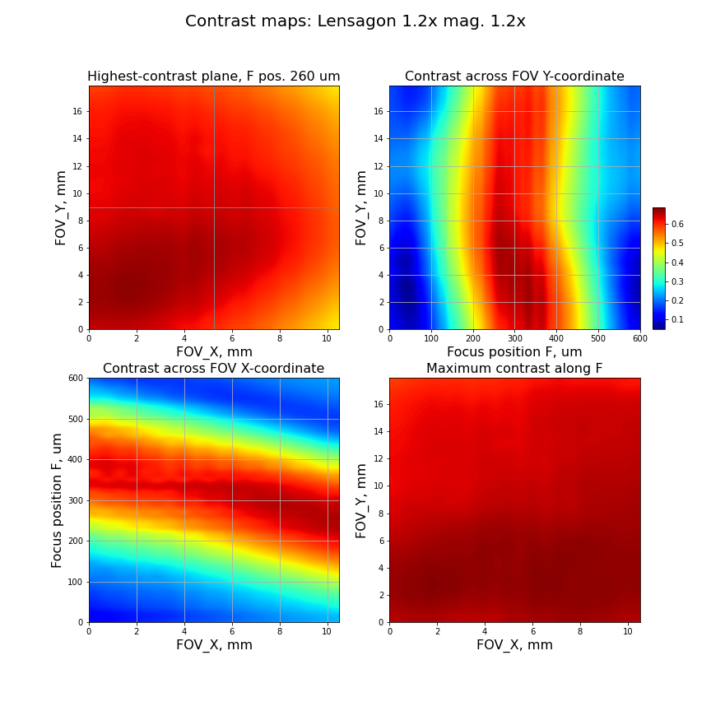
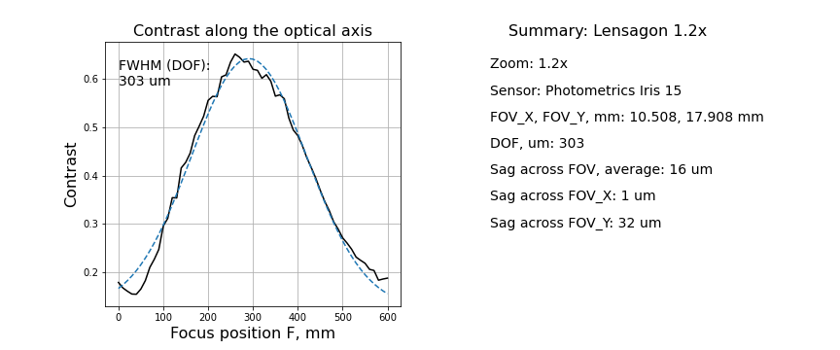
Is MVPLAPO-1x a good lens?
Sag across FOV (10.6 mm): 67 um
Sag across same FOV: 18 um (3.7x smaller)

Slide 9
Todo: repeat Lensagon test, with more accurate axial alignment of the target.

